Slide 1
Satellite farm 程式使用說明
Aug, 2019
黃梓育

Slide 2
Code Architecture
main.py
analysis
util
preprocessing_visual.ipynb
data_parser.py
preprocess.py
convert_CRS.ipynb
ziyu_model.py
evaluate.py
tif_to_shp.ipynb
shpfile_statistic.ipynb
train.py
loss.py
Graph definition:
Execution file
Folder
Operation function

Slide 3
File utilites
main.py ---------------------------------- Main function
util
data_parser.py ---------------------------------------- Data loading and preprocessing for model using
preprocess.py------------------------------------------ Target Data preprocessing
ziyu_model.py ---------------------------------------- Neural Network computational graph definition
train.py -------------------------------------------------- Training, save model and recording history
evaluate.py --------------------------------------------- Testing and plotting
loss.py ---------------------------------------------------- Loss function definition
Analysis
preprocessing_visual.ipynb ------------------------- Visualization for preprocessing target data
convert_CRS.ipynb ------------------------------------ Convert shape/tiff file projection(CRS)
tif_to_shp.ipynb --------------------------------------- Convert tiff file to shape file
shpfile_statistic.ipynb -------------------------------- Calculate some statistic value in target region

Slide 4
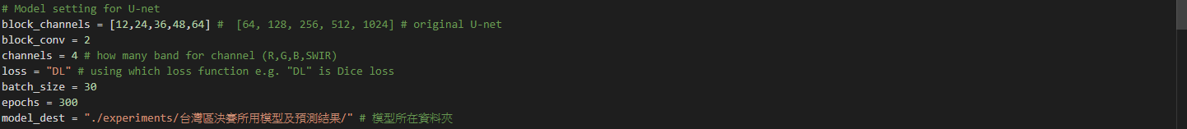
Arguments
Define in main.py
Model structure
-blocks
-block_conv
-block_channels
-channels
Training argument
-loss
-batch_size
-epochs
-model_dest
Data parser
-target_path
-training_path
-box_size
-using_data
-clip_shp_path

Slide 5
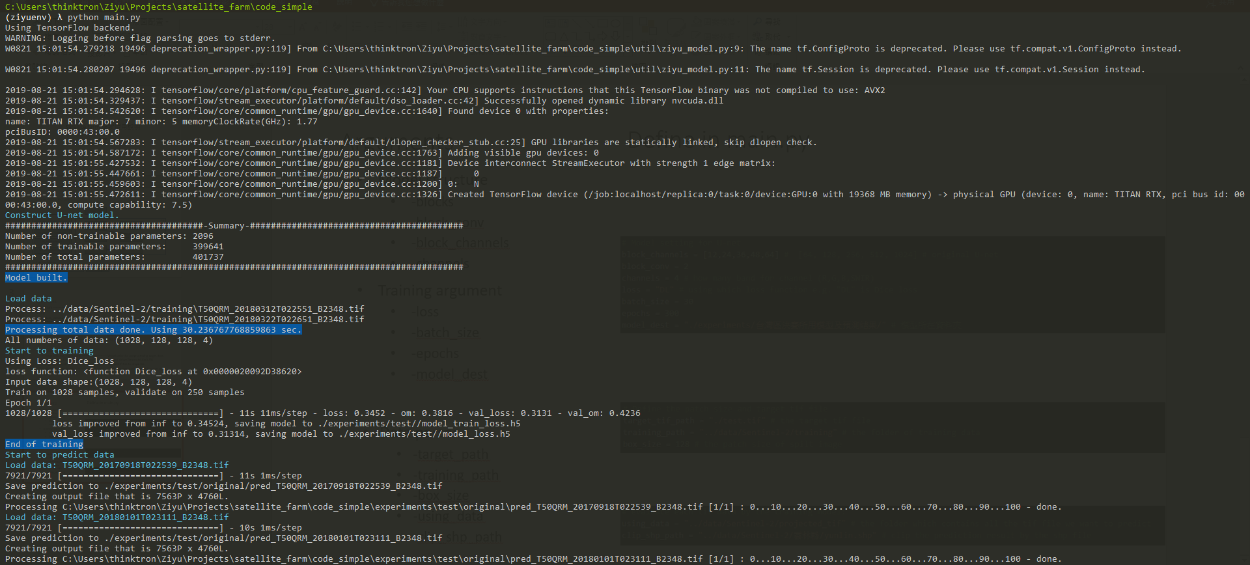
Main : Execute for training and evaluating
Execute the file with following command under terminal (or cmd) to train the model and evaluate the data
$$ python main.py
Load tensorflow and activate GPU we use
Create the neural network model in GPU
Loading data for training and validation, split ratio is 0.2 ( train : valid = 8 : 2)
Save the weight “model_loss.h5”of model under model folder
Train the model
Plot the data from the model predict and clip by shape file
Prediction result will save in “original” folder which is under the model folder
Clip result will save in “clip_result” folder which is under the model folder

Slide 6
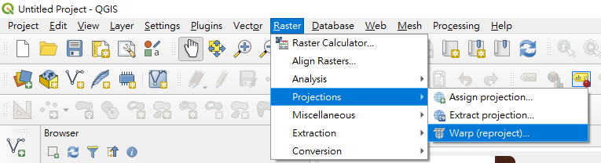
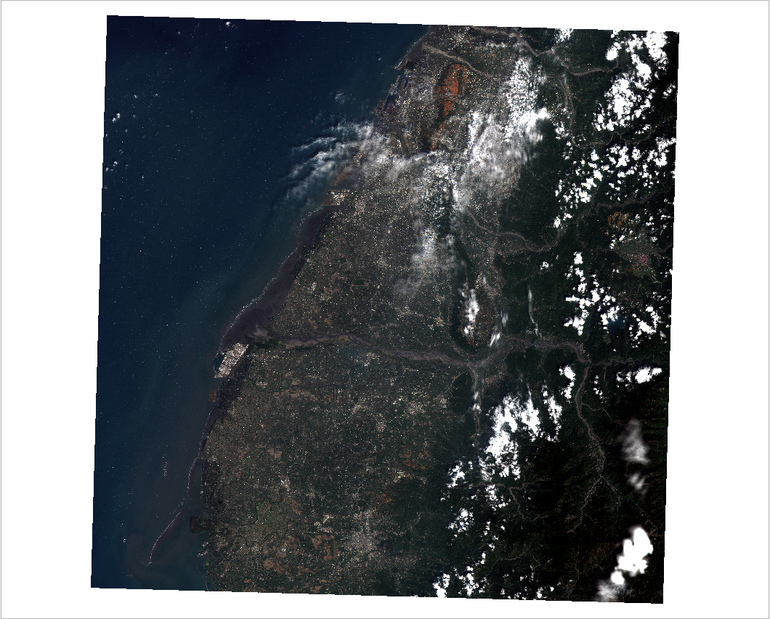
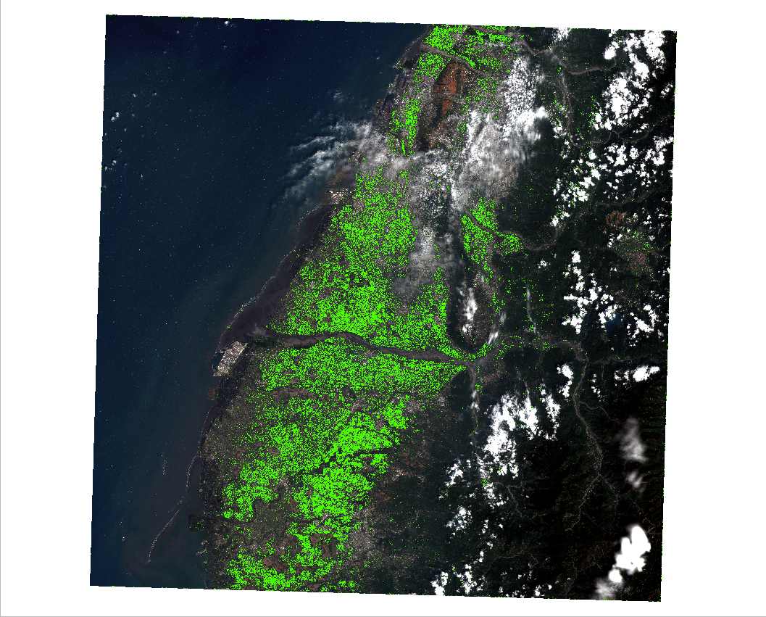
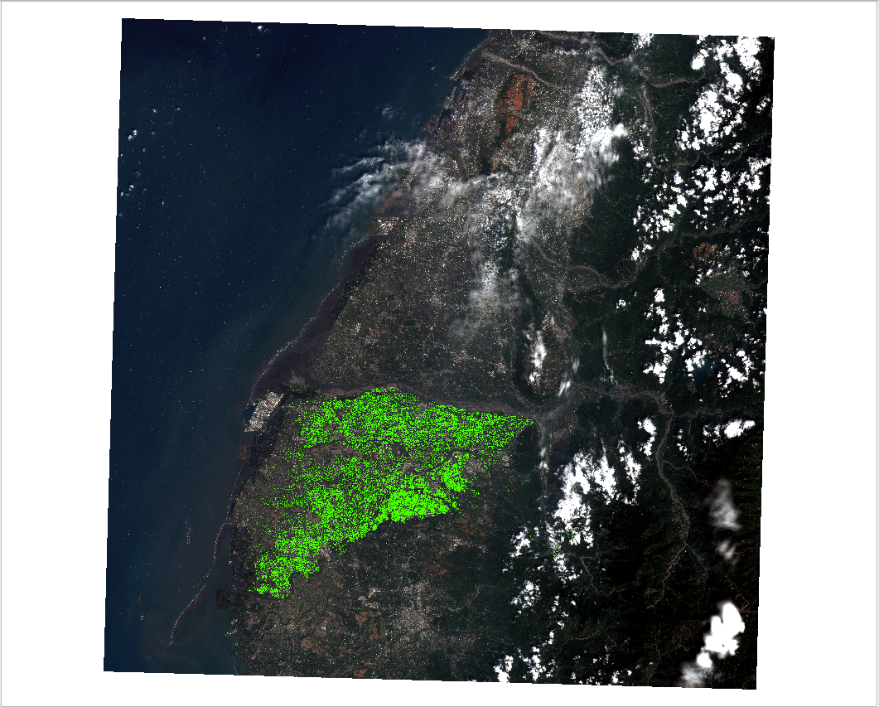
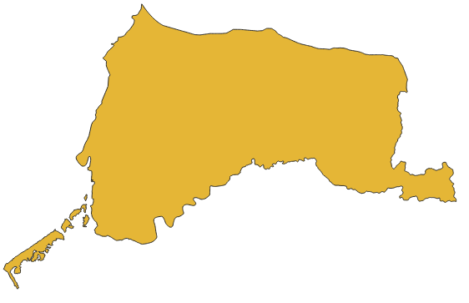
Input data and model result
Display the tiff file by the QGIS3
If the EPSG of tiff data is not 3826, you can convert it by the file “analysis/convert_CRS.ipynb” or convert by QGIS
Input tif data
(EPSG:3826)
Prediction overlay on input data
Prediction clip by target region
overlay on input data
Our model

Slide 7
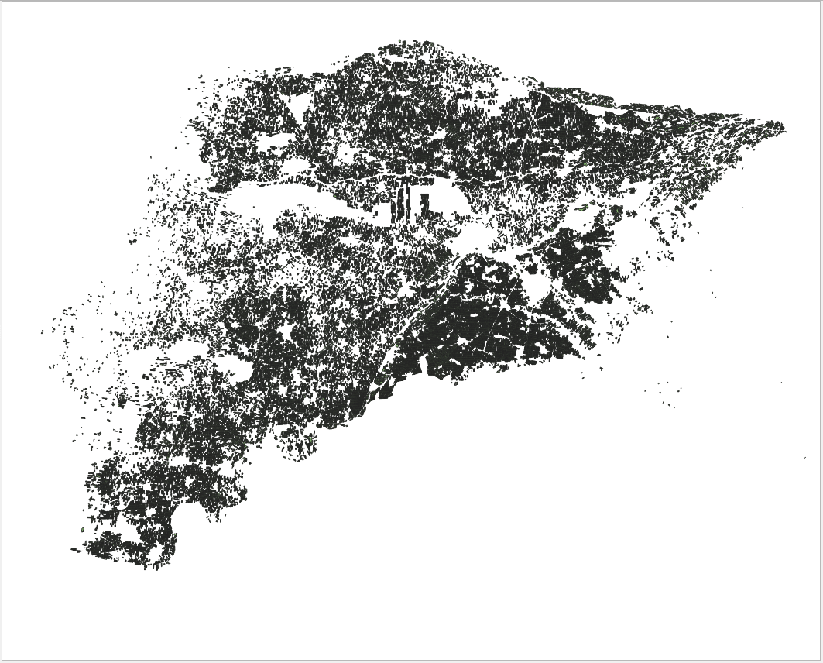
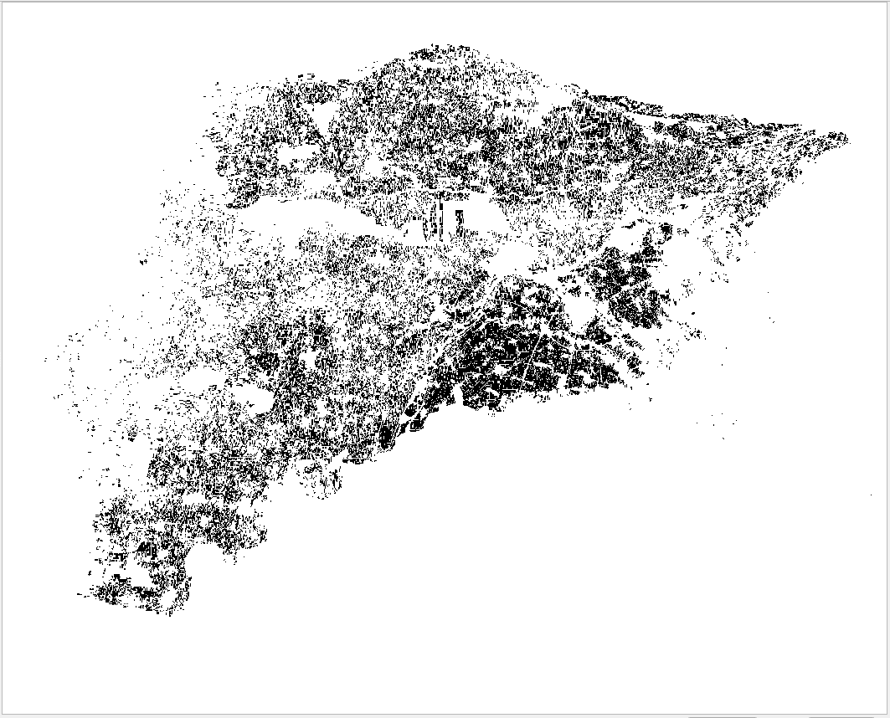
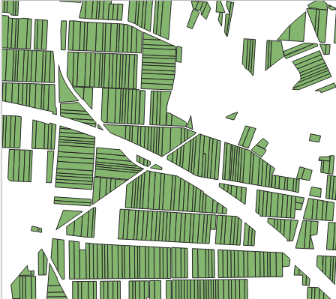
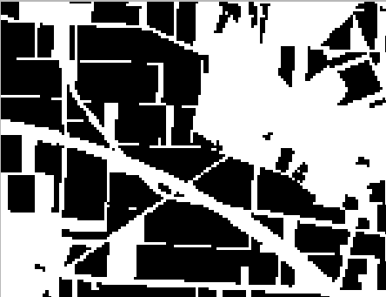
Target data
If you need to convert new Cadastral shape file to tiff which is using for training, change the setting in “util/preprocess.py” and execute the file with following command under terminal (or cmd).
$$ preprocess.py
Shape file
A collection of polygon point
(It is hard to use for training pixel-wise model)
Tiff file
Each target is a bool value for each pixel

Slide 8
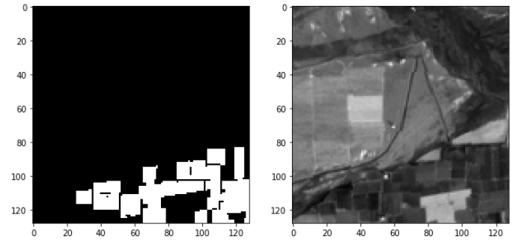
preprocessing_visual
When using “preprocess.py” to create the target data, we can using “analysis/preprocessing_visual.ipynb” to check the result.
Spilt target tiff file
Spilt red channel tif

Slide 9
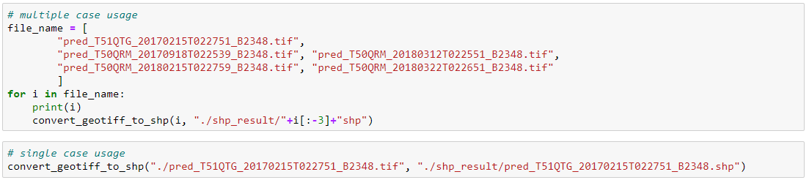
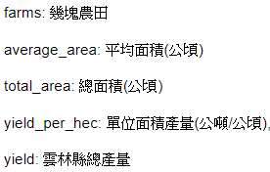
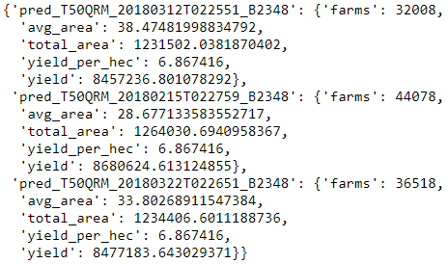
tif_to_shp and shpfile_statistic
After predict the file, if we want to get the result as a shape file which is a collection the polygon of each area. You can use the “analysis/tif_to_shp.ipynb” to convert tiff file to shape file.
With the shape file, we can calculate some statistic like following:

Slide 10
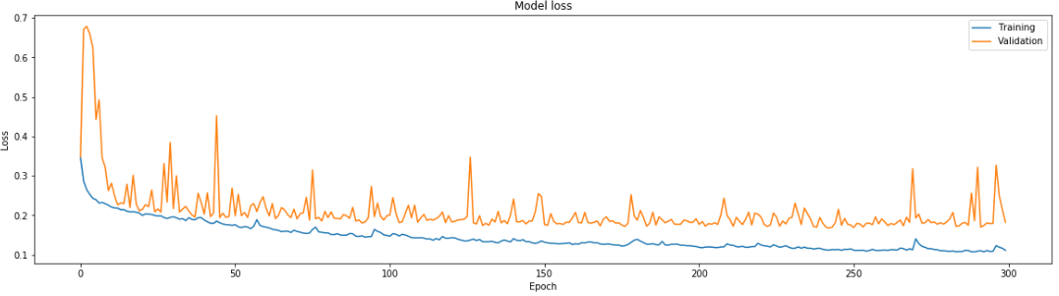
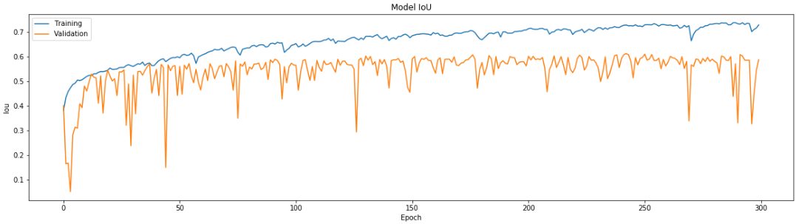
Plot training history
Analysis the IoU (Intersect over union) or loss value of each epoch.
Change the model_path to check another model result.

